Slide 1
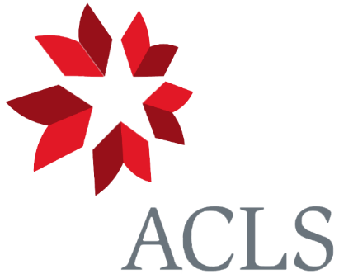
Digital Justice Grants Program : General Information Session
Keyanah Nurse, PhD
Senior Program Officer, IDEA Programs
Katie Reis
Program Associate, IDEA Programs
September 18, 2024
Notes:
Good afternoon, everyone!!
My name is Keyanah Nurse, Senior Program Officer of IDEA Programs, a new unit at ACLS which stands for Intentional Design for an Equitable Academy. I’m joined by my colleague Katie Reis, Program Associate of IDEA programs, managing the tech behind the scenes.
As the program lead for the Digital Justice Grant program, now entering its third competition year, I’m very happy to be with all 130+ of you to both discuss some of the big picture aspects of the program (its core mission and values), as well as some of the nitty gritty details such as the application components and eligibility requirements. But in that work, I’m also eager to share the ways that this program continues to morph and evolve, primarily motivated by the generous feedback we receive from our primary constituency – YOU. In that spirit, I’ll also highlight not only some substantial changes to this year’s application, but also explain the rationale, and the aspirational vision, behind them.
As always, this session will be recorded, so that those with scheduling conflicts can still access the materials.

Slide 2
Session Overview
Program Parameters and Ethos
Eligibility
Examples of Funded Projects
Application Components
Important Dates
Q&A
Notes:
As I mentioned, today’s session encompasses a mix of discussion both about the ethos of the ACLS Digital Justice Grants program, but also explaining some of the finer details of this year’s competition.
After defining the vision for it by highlighting how and why the program is designed in the way it is, as well as uplifting some of the currently funded projects, I’ll then explain some key details about eligibility, particularly the difference between Seed and Development Grants; give an overview of the application components, which have been restructured for this year’s competition; highlight some dates on the competition timeline, and leave some time at the end for Q&A.
Given the volume of participants today, we will use Zoom’s Q&A feature, which my colleague Katie will be monitoring. Please post your questions there throughout the session, and be sure to upvote the questions that you would like to see answered. Obviously, we won’t have time to get to everyone’s individual inquiries, but I do hope I can answer questions that many people have in common. I would also encourage you to try to frame your questions as generally as possible. If you have specific concerns or questions about your individual project, I’ll explain how best to get in touch with us about that to receive some feedback.

Slide 3
I. ACLS Digital Justice Grants:
Program Parameters and Ethos
Notes:
So let’s begin with the program parameters and ethos of the Digital Justice Grants program. It’s important to start here because I want to underscore the **specificity** of what this name “digital justice” means at ACLS and within the context of this program. This isn’t so much an exhaustive definitional effort – I’m not defining the incredibly complicated and multifaceted term “digital justice,” or talking about how the term is used in other spaces – but rather making plain why we mobilize the aspirational and reparative spirit of justice in the very name of this program, so that you have a better sense of whether or not your project would be a good fit for it.

Slide 4
….an intentional grantmaking design process meant to support digital projects in the humanities and interpretive social sciences that critically engage with the histories and interests of people of color and other marginalized groups through the ethical and intentional use of digital tools and methods.
Notes:
When we invoke the term “digital justice,” again within the context of this program, we are referring to an intentional grantmaking design process meant to support digital projects in the humanities and interpretive social sciences that CRITCALLY engage with the histories and interests of people of color and other marginalized groups THROUGH the ETHICAL and INTENTIONAL use of digital tools and methods.
You’ll notice in that framing, we position “digital justice” as both a process and an outcome, with a specific thematic and methodological focus. And while the general contours of that process are, in fact, applied to other programs in the IDEA unit, it’s application here animates a program that aspires to be attuned to the specific needs and challenges that go with supporting historically underfunded topics of study, doubly so when they are made digital.

Slide 5
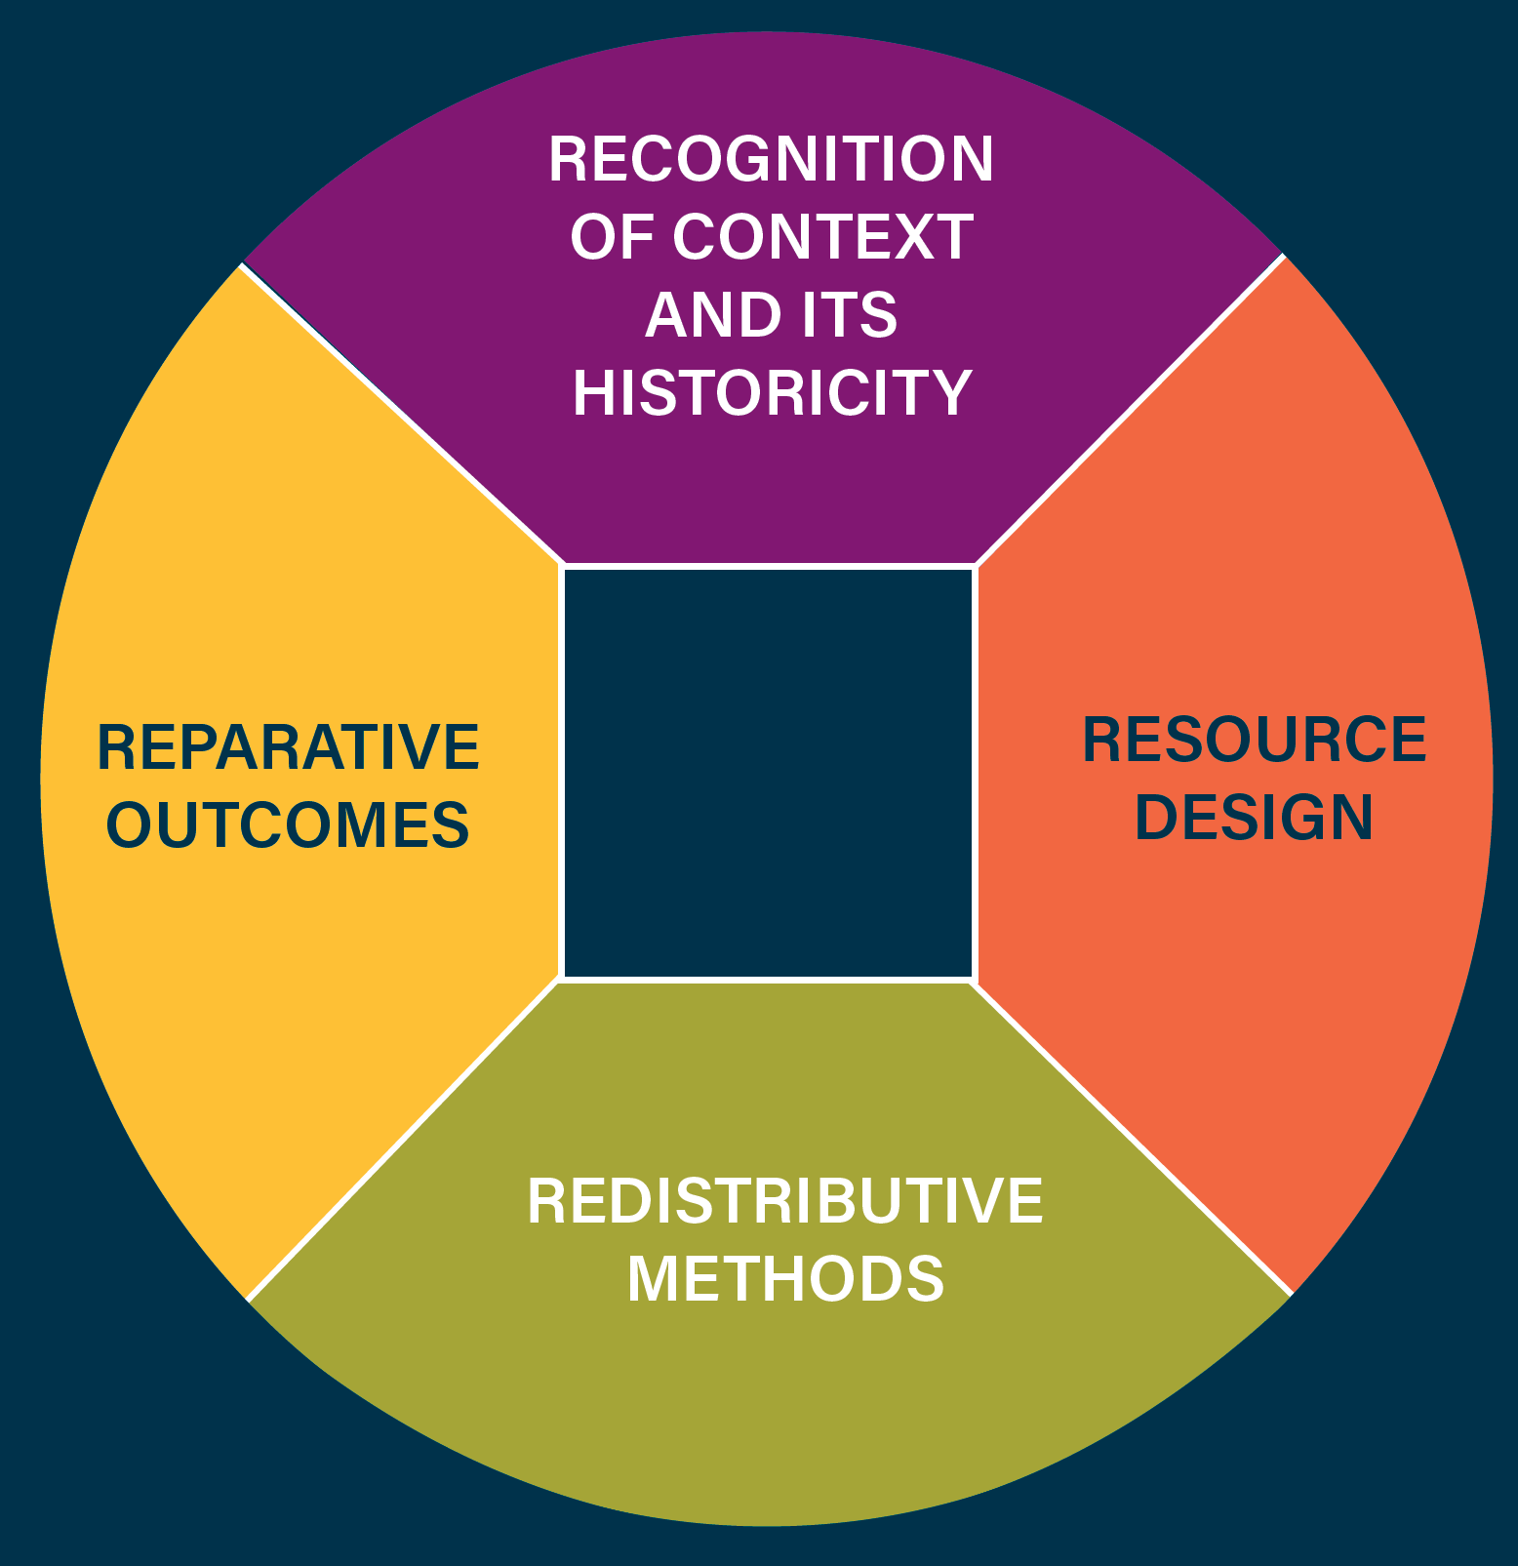
Intentional Grantmaking:
Digital Justice as Process and Outcome
Notes:
Here’s a quick visual that captures how we understand the four modes of iterative and interlinked activities that constitute that intentional design process. But what do these activities look like concretely, within the context of the Digital Justice Grants Program?
Recognition of context and its historicity: How did we get here? Why are there certain fields within the realm of DH that can more readily access funding over others? That’s mostly a rhetorical question, since we know the answers to these questions and why the landscape is uneven. Our current educational landscape was never designed to support Black studies, or trans studies, and those very inequities in funding and institutional prioritization and investment have mapped themselves onto the digital sphere. It’s the very context that drives subsequent decisions about how the Digital Justice Grants program is designed and administered.
Intentionality of resource design: For example, the very structure of the program– in this case, the bifurcation between Seed and Development grants, is intended to further redistribute the privilege of experimentation and risk-taking to those who have had to do that work with far fewer resources. Innovation and advancements in scholarly fields, especially for digital project, happen precisely through experimentation and risk-taking, two activities that we see as fundamental, even if not properly recognized in the demands for “return on investment” especially within the genre of grant writing.
You can also see the intentionality behind resource design as well with our webinar series. They are curated based on feedback from reviewers about areas where they see the applicant pool needs more coaching, and from applicants who express a desire for more advisement on specific components of their application. I will talk about the webinar series a little later in this session, but I wanted to flag the reasoning behind their specific topics early on.
Redistributive methods: relatively new thread of capacity building (introduced last year), which prompts applicants to give a more granular understanding of the context in which they pursue their work so that our reviewers can select awardees based on where the funds might do the most good insofar as bolstering the creation of DH scholarship.
We don’t expect applicants to articulate how their projects will solve all the problems at your respective institutions. We want to be attentive to scale here. But it is our hope that the prompts around capacity building can give our reviewers a more granular understanding of the context within which our applicants pursue their work so that we can better funnel resources where they have the potential to do the most good – bolstering the capacity for pursuing digital scholarship in the US.
This thread of capacity building, I’ll also quickly note, emerges from our Commission on Fostering and Sustaining Diverse Digital Scholarship. Throughout fall 2022 and winter 2023, ACLS convened a variety of focus groups of different constituencies throughout the ecosystem of digital scholarship. In the Commission’s focus groups featuring former and current DEXT and Digital Justice grantees, the participants noted that project teams are well positioned to articulate what “capacity building” could look like within the specificity of their institutions. This insight pushed us to consider what a prompt around capacity building might look like, one that respected the diversity and specificity of institutions and that didn’t encourage a kind of philanthropic paternalism where ACLS decides what capacity building looks like for each project team.
Reparative outcomes: And finally, we get to the reparative outcomes, which are always aspirational and always grounded in answering the question: how can we support and fund restorative, reparative, and sustainable experimentation with technology that opens avenues for more transformative relationships to the past, present, and future?

Slide 6
III. ACLS Digital Justice Grants:
Eligibility
Notes:
Now that I’ve spoken a little bit about the big picture vision and intention of the program, I’ll transition into reviewing some of the concrete details of the competition and application that might be helpful as you craft your materials. The first detail, is of course, determining if your project is eligible for consideration.

Slide 7
Eligibility
At least one of the project’s principal investigators must be a scholar in the humanities and/or the interpretative social sciences.
Projects must be made as widely available as intellectual property constraints allow, ideally with the most liberal open-source and Creative Commons license that is appropriate for the underlying content.
An institution of higher education in the United States must administer awarded grant funds.
Notes:
The first eligibility requirement is that the principal investigator must be a scholar in the humanities. During the pilot year, we received a lot of inquiries about what this meant, particularly whether or not we were limiting our definition of scholar to those with PhDs or faculty positions. We are not. Given the very collaborative nature of digital work, especially the extent to which librarians are often at the center of some of these projects and the ways in which graduate students partner with faculty members, I want to make clear that our definition of a scholar for this program is one with a demonstrated track record of engagement in scholarly debates and communities, whether by publications, conference presentations, or collaborations with other scholars both in and outside their fields. It’s not limited to professional title or credential.
The second eligibility requirement is about the extent to which project teams agree to make their content publicly accessible. This used to be in the form of the intellectual property agreement, which was an application component. We have since folded this into the eligibility requirement to pare down the application packets for our reviewers. But I also want to flag a key phrase here which is that project teams agree to the most liberal open-source and Creative Commons license that is APPROPRIATE FOR THE UNDERLYING CONTENT. We are in the process of developing much more culturally sensitive and updated guidelines here, ones that take into account that not all materials can or should be widely accessible, especially when they belong to communities who have historically been subject to plunder and are currently subject to various kinds of harassment, both online and off. For now, however, we are deferring to project teams and encouraging them to articulate to us in their dissemination plans how people will be able to access their content.
The final eligibility requirement is that an institution of higher education in the US must administer awarded grant funds. In the pilot year, we required that these institutions needed to “host” proposed projects, but it’s not actually the case that we require your institutions to provide the servers on which your content lives. You may certainly use those if you have easy access to them at your institution, but digital ownership doesn’t need to belong to your institution. We’ve since changed the language here to reflect a financial relationship. That a larger institution will administer grant funds. If you are not formally affiliated with an institution, I recommend partnering with someone who is – and in any case, the strongest applications always feature a project team rather than individual scholars.
I would like to flag that this stipulation is something we are working towards changing. ACLS has a precedent of distributing award funds directly to scholars through our Central Fellowship and I have discussed with my colleagues what kinds of financial processes we already have in place that would give us more flexibility with funding distribution models. There’s some additional complexity that comes with distributing funds to project teams that we’re still working through. But it’s very much on our radar.

Slide 8
Eligibility: Seed v. Development Grants
Seed Grants | Development Grants
Project must be within the start-up or prototyping phase of development. | Projects must demonstrate evidence of significant preliminary work as well as a record of engagement and impact with scholarly and/or public audiences.
Notes:
The three eligibility requirements that I just described apply to both Seed and Development Grants, but there is one requirement between the two that varies, and that’s about assessing what phase of development your project is in. Seed Grants, as the name implies, are for start-up projects that are in the prototyping/proof-of-concept phase. By contrast, Development Grants must demonstrate evidence of significant preliminary work as well as a record of engagement with public and/or scholarly audiences.
Given that distinction, you may be wondering – as many people ask during the pilot competition– WHICH GRANT SHOULD I APPLY FOR?

Slide 9
Eligibility: Seed v. Development Grants
Technology:
Have I tested software, hardware, and digital products/ content?
Relationships:
Have I identified which partnerships are necessary for my work?
Public/ Scholarly Audiences:
Are there publications, exhibits, and/ or events I can discuss?
YES
NO
YES
NO
YES
NO
SEED
DEVELOPMENT
SEED
DEVELOPMENT
SEED
DEVELOPMENT
Notes:
We have here some very basic, but by no means exhaustive or prescriptive, considerations that may help you determine which of the grants is the best fit for your project.
In terms of technology, you can ask yourself about the extent to which your project has already tested the software, hardware, or digital products featured in the project. If you have not and this is your first go at it, that’s a good indication that you should apply for a Seed Grant. If you’ve already done some of that testing and have a clear rationale behind why you’re using a specific tool or platform, that may be an indication that a Development Grant is a better fit.
Same principle applies to the human relationships and partnerships necessary to carry out this work, both on your campus or off it. If you have identified them, what work have you all done together already?
Finally, consider the project’s history engaging with public and/or scholarly audiences. If you can cite and describe any publication, exhibits, events, websites, apps – or anything of the sort – that has connected your project with an audience, that is also a good indication that you should apply for a Development Grant.
Although we’ve framed the answers to these questions as a binary Y/N, we recognize that most of these answers will exist on a spectrum, and you’ll have to use your own discernment about where on the spectrum the nuances and history of your project live. But I’m also going to give concrete examples of two Seed and two Development projects, which you can find on the ACLS site, to demonstrate those differnces, but also present the diversity of activities that go into a “digital justice” project.

Slide 10
II. ACLS Digital Justice Grants:
Examples of Funded Projects
Notes:
We often get the question of “what counts as a digital justice project”? The short answer to that is when we think of “digital justice” at ACLS, we’re really thinking of humanities or interpretive social sciences projects critically engage with the interests and histories of POCs and other marginalized groups through the ethical and intentional use of digital tools and methods. I especially want to flag that second part about the ethical and intentional use of digital tools and methods. All ACLS Digital Justice projects feature a very profound, and intentional relationship between form and content. It’s usually very clear how the tools and methods inform both the project’s intellectual contributions and its advancement of equity and justice.
I think it’s much more helpful, however, to go through examples of the of digital projects we have funded through this program, so you get a clearer sense thematically and methodologically of what a “digital justice” project looks like, but also to underscore this difference between Seed and Development projects.

Slide 11
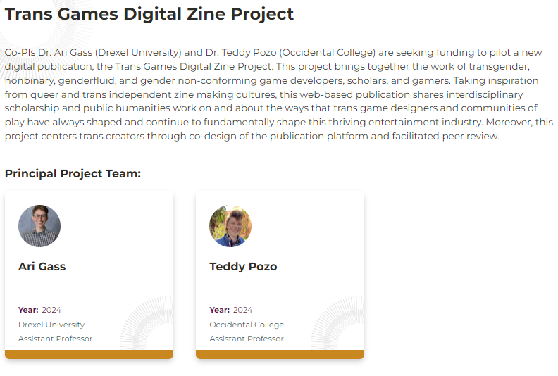
Seed Grant Example
Activities
Co-designing digital platform with trans creators
Outputs & Digital Deliverables
Web-based zine about influence of trans game designers
Notes:
The first example of a project that received a Seed Grant is the Trans Games Digital Zine Project led by Professors Ari Gass (Drexel) and Teddy Pozo (Occidental College). Bringing together the work of transgender, nonbinary, genderfluid, and gender non-conforming game developers, scholars, and gamers, this web-based publication will share interdisciplinary scholarship and public humanities work on and about the ways that trans game designers and communities of play have always shaped and continue to fundamentally shape this thriving entertainment industry.
Seed funding here will be used to develop and prototype this digital publication through a co-creative process with those trans creators. And so while this team already did some preliminary work in terms of identifying which partners they would work with, the proposed activities that ultimately got funded were the piloting of a new publication platform.

Slide 12
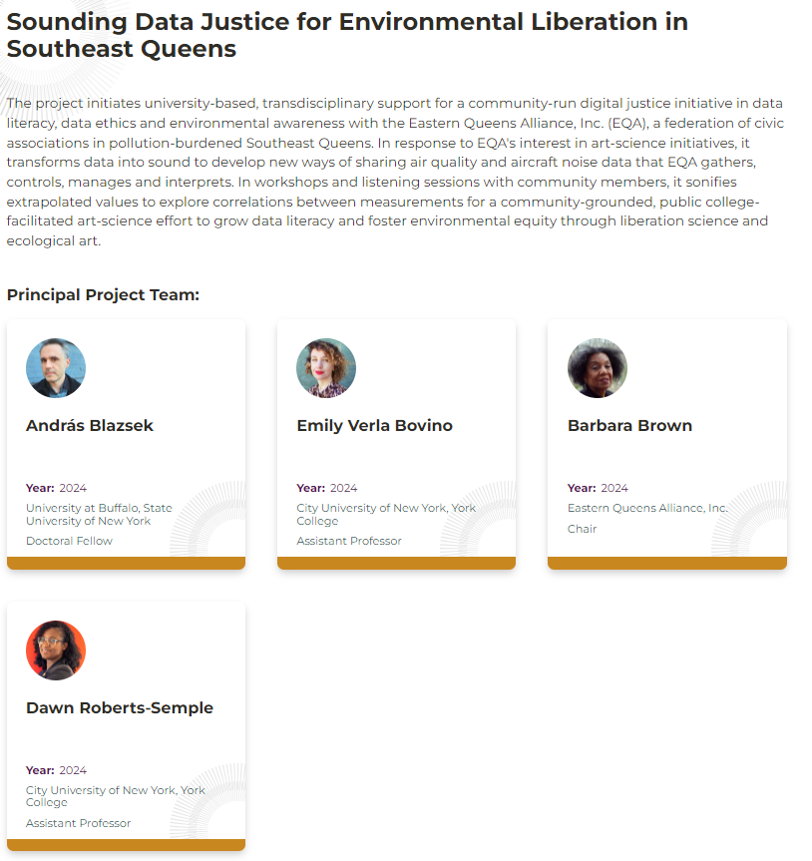
Seed Grant Example
Activities
Data collection, interpretation, and sonification
Outputs & Digital Deliverables
Community workshops, compositions
Notes:
The next project is Sounding Data Justice for Environmental Liberation in Southeast Queens, which is a collaboration between faculty members at CUNY York College and the nonprofit the Eastern Queens Alliance. It's an art-science initiative, that transforms data into sound to develop new ways of sharing air quality and aircraft noise data that the EQA already collects. The ultimate goal of the project, which is community-run yet university-based, is to grow data literacy and foster environmental equity through liberation science and ecological art.
Just as in the previous project, the partnerships between the faculty and community partners were already in place when the teams applied. So the funded activities are really oriented towards exploring a new method. In this case, data sonification is the new, experimental method that will be tested through the project, particularly with respect to how sonification, as opposed to the more familiar visualization, may be better able to facilitate data sharing by community organizations with outsiders.

Slide 13
Development Grant Example
Activities
Collection of written and oral materials, working with story-telling consultants
Outputs & Digital Deliverables
Digital archive, story-telling community events
Notes:
The first example of a Development project is the Freedom & Captivity Archive Project: Archiving Carceral Experience, a collaborative project between Colby College, the Maine Prisoner Advocacy Coalition, and the Maine Historical Society. Since 2020, the larger Freedom and Captivity Initiative has curated and facilitated community conversations in Maine that envision alternatives to incarceration, while centering those with the most direct experience with the carceral system. Previous activities of this project, which began in 2020, included 15 art exhibitions in galleries throughout the state of Maine, an online exhibition, and a podcast series among other activities.
For their Digital Justice Development Grant, they will be extending this project to build out a publicly accessible digital archive of the experiences, insights, knowledges, and hidden stories of Maine’s incarcerated and formerly incarcerated community members, which will then form the basis for community story-telling events throughout the coming year.

Slide 14
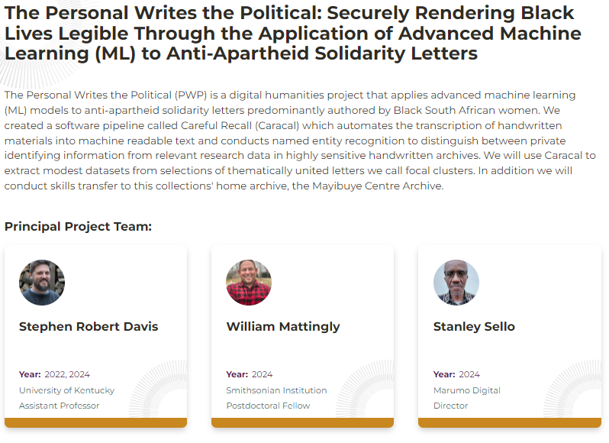
Development Grant Example
Activities
Training sessions
Outputs & Digital Deliverables
Refined compartmentalized workflow
Notes:
The last example of a Development Grantee is The Personal Writes the Political: Securely Rendering Black Lives Legible Through the Application of Advanced Machine Learning (ML) to Anti-Apartheid Solidarity Letters, a transnational team that stretches from Kentucky, Washington D.C. and Cape Town South Africa. This team actually won a Digital Justice Seed Grant back in 2022, and through that work , the team used machine learning models to identify relationships, recognize handwriting, and redact sensitive information from about 700 letters written by family members of imprisoned anti-apartheid activists.
Now, the team will use their Digital Justice Development Grant to implement solutions based on the project’s first phase and hold training sessions at the Mayibuye Centre Archive, the collections’ home archive in Cape Town.

Slide 15
IV. ACLS Digital Justice Grants:
Application Components
Notes:
Now that I’ve spoken a little bit about the big picture of the program and discussed the differences between the Seed and Development Grants, I’ll transition into reviewing the application components, which feature some important changes from last year’s application.

Slide 16
Application Components
Prompts
Bibliography
Institutional Verification
Staffing
Timeline
Budget and Budget Description
Statement of Support from Community Partners
Notes:
Both the Seed and Development Grants have the same application components, which include elements such as the bibliography, project timeline, project budget and budget description, project staffing, and institutional verification. There are some key differences between last year’s application and this one’s, which I’ve coded here in orange.
For those of you who applied last year, you may remember the 7- or 10-page proposal narrative that comprised the bulk of the application. For this year, we’ve replaced that model with a series of discreet prompts with word count limits rather than page count limits.
There are a few reasons why we shifted to this structure. For starters, this past spring, reviewers offered some critical feedback about the structure of the application, and about the kind of information they want to be able to more readily access as they go through an application. The most significant insight they offered was that applicants often spent too much time within the proposal narrative talking about the intellectual underpinnings of a project, and not nearly enough talking about the project’s mechanics – it’s tools, methods, etc.
Interestingly, we heard a similar concern from applicants during our Digital Justice focus groups, which we hosted this summer. During those sessions, applicants very generously shared their experiences navigating the competition and offered some really helpful suggestions around how we might change the structure of the application so that folks are better positioned to provide the information that reviewers actually want and need in order to advocate for their projects.
So rather that sticking with the proposal narrative upload format, we’ve now shifted to a prompt-based model that asks very pointed questions about the different dimensions of your project. This, I hope, will not only streamline the reading and evaluating process since similar types of information will be available in the same place across applications, but I also hope that it makes completing your application a little more straightforward. The prompts with their word count limits will give you a better sense of how much space to allot to different dimensions of your project. You no longer have to guess, or better yet, simply know those unstated, unwritten rules about grant writing that dictate where you should put certain pieces of information about your project within a proposal.
I’d also like to thank the independent, disabled scholar Tekla Babyak for pointing out that word counts rather than page counts make drafting the application a lot more accessible for those with visual impairments who may have to reformat their materials after they draft them.
We’ve taken all those pieces of feedback and implemented them within this new structure. But since this is the first time we are trying this, we will also be asking if folks would like to participate in our focus groups next summer in order to give some feedback about their experiences navigating it.

Slide 17
Application Components
Prompts
Bibliography
Institutional Verification
Staffing
Timeline
Budget and Budget Description
Statement of Support from Community Partners
Key Reminders:
Prompts, not narratives
No letters of recommendation
Institutional verification
Supplementary materials
Notes:
Aside from the specific application components, I do want to uplift that we are continuing with excluding formal letters of recommendation from the application. None of the reviewers from last year’s competition reported that their ability to evaluate applications was lessened because they didn’t have letters. No one missed them! They did, however, recommend asking for brief statements of support from community partners (if a project features them) so that they wouldn’t have to extrapolate the nature of that partnership based on the materials. So that is an added component to be mindful of this year; if your project features extramural community partners, you’ll need to have them provide a very brief – no more than one page double spaced– letter of support that details the nature of the partnership.
The last thing I’d like to underscore with respect to the application itself is the institutional verification, which is not a formal letter of recommendation. It is a form that should take no more than 20 minutes to complete, which we note in the instructions that are sent to the administrators who will submit this on your behalf. The form asks administrators to confirm that the grant funds will be distributed through their institution, that any activities done for the grant can be counted for tenure and promotion, and that grantees can use any available tech infrastructure at the institution for their projects. That’s it.
Finally, in our ongoing efforts to provide more resources in how to apply to our grants and fellowships, prospective applicants can still access supplementary materials, including a budget template, sample application materials from the 22 cohort of Digital Justice grantees, and recordings of last years webinars on data ethics and capacity building. My colleague Katie will now be posting the link to those materials in the chat, but you can also find them on the program page for the Digital Justice Grants on the ACLS site.

Slide 18
V. ACLS Digital Justice Grants:
Important Dates
Notes:
The last topic for today is the competition timeline, and to review some important dates that should be on your radar.

Slide 19
Deadline for Applications:
December 3, 2024
9 PM EST
Notification of First Round Review:
February 2025
Notification of Final Review:
April 2025
Notes:
The most obvious date is the deadline for applications, which is December 3, 2024 at 9 PM EST. After this date and time, our online fellowship application will no longer allow for submissions, and unfortunately, we cannot allow for extensions of any kind. This date is also the deadline by which the administrators at your respective institutions should submit their institutional verification. For that reason, if you are applying, I recommend you register in the application portal as soon as possible so that you can submit your administrator’s email address, and our portal will send them the instructions on how to submit the verification form.
Given the increased volume of applications we received in last year’s competition (I believe there was about a 140% increase in applications compared to the 2021-2022 competition), we’ve had to also restructure our review process and institute an additional round of review. The results of that first round of review will be shared February 2025, followed by the results of the final round of review in April.

Slide 20
Digital Justice Fall 2024 Webinar Series
September 18, 2024 | 2 PM ET | General Information Session | ACLS Staff
October 2, 2024 | 11 AM – 12:30 PM ET | Digital Justice in Practice: Tools, Methods, Deliverables | Rachel Kuo Tatiana Bryant
October 17, 2024 | 1-2:30 PM ET | Cultivating Community Partnerships in DH | Charlotte Nunes Ricardo Punzalan
October 29, 2024 | 3:30 – 4:30 PM ET | Office Hours | ACLS Staff
November 14, 2024 | 2-3:30 PM ET | Operationalizing DH projects: Budgets, Timelines, Workplans | Andre Brock TBD
November 22, 2024 | Office Hours | ACLS Staff
Notes:
I also want to highlight the schedule for the Digital Justice Fall webinar series, since there is still time to register for those that are relevant to your project. We developed this series, along with curating the supplementary materials that you can find on the ACLS site, as a way of making plain the “hidden curriculum” that goes into grant writing.
This general information session was the first of six, all of which will be recorded. The “office hour” sessions with ACLS staff – one in late October and another right before the deadline in late November -- will primarily function as an opportunity to get more information about program parameters and to ask specific questions related to your project.
The other three sessions, which feature invited interlocutors who have served as reviewers in former years for Digital Justice, are specific to topics that appear in the application prompts and have been curated specifically according to feedback we’ve received from former reviewers as well as applicants about different areas they’d like more coaching on.
On October 2, we’re joined by Professor Rachel Kuo from the University of Wisconsin-Madison, as well as Tatiana Bryant as they discuss best practices for articulating the how-to of your digital project.
A few weeks later, on October 17, Charlotte Nunes (Lafayette College) and Ricardo Punzalan (University of Michigan) will be joining us to discuss cultivating community partnerships in digital humanities.
And then our last webinar will feature Andre Brock and another interlocutor as they discuss operationalizing your digital project, with a specific eye to crafting budgets, timelines, and workplans.
Just as we did last year, the format of the 90-minute sessions with our interlocutors will open with a 30-minute discussion about the topic, followed by 40-50 minutes of breakout sessions where you can engage them more directly and get some targeted feedback on your application.
I’m going to ask my colleague Katie to pop the link to register for those sessions in the chat, so you have it for your reference. And we hope to see you there!

Slide 21
VI. ACLS Digital Justice Grants:
Q&A

Slide 22
Thank you and best of luck on your application!
For further inquiries, please email:
digitaljustice@acls.org
Notes:
As we wrap up, I want to extend a warm thank you to everyone who attended today and asked questions, which always works to the benefit of the group. As I mentioned, this session will be recorded and uploaded to YouTube, so you are able to reference it or send it to colleagues who may have missed the session. The slides will be posted to the Digital Justice program page; and we will send a follow up email directing you to that early next week.
Before you go, however, I do want to ask a small favor. I’m a firm believer in the value of revision, not just to writing or developing projects, but also to programs like this. One of the primary ethos of Digital Justice’s larger unit IDEA is to approach this work iteratively, and as much as we’ve changed to make the program live up to the aspiration of Digital Justice, we recognize that there’s still more to do. As you’ve heard today, we rely on the candid feedback of applicants to make the necessary adjustments and changes to the program that make the process of applying less onerous, that offers some resources for folks that they can leverage for other opportunities (even if they are not selected as a grantee), and that lower the barriers to entry for applying.
Katie is going to post in the chat a link to a post-webinar survey. It’s very short – five questions – that hopefully give us a sense of how useful these sessions are.
The survey also asks you to consider whether or not you’d be open to being contacted about participating in a focus group in the summer, once the competition is over, about your experiences navigating the competition. The answer to this question now doesn’t lock you into participating, it simply gives us a starting point for outreach once we do the work of inviting folks to that focus group.
So once again, thank you for your time. Best of luck with your application and if you have any further inquiries, you can send them to digitaljustice@acls.org

